Slide 1



NCAA INITIAL ELIGIBILITY
For College-Bound Student-Athletes

Slide 2
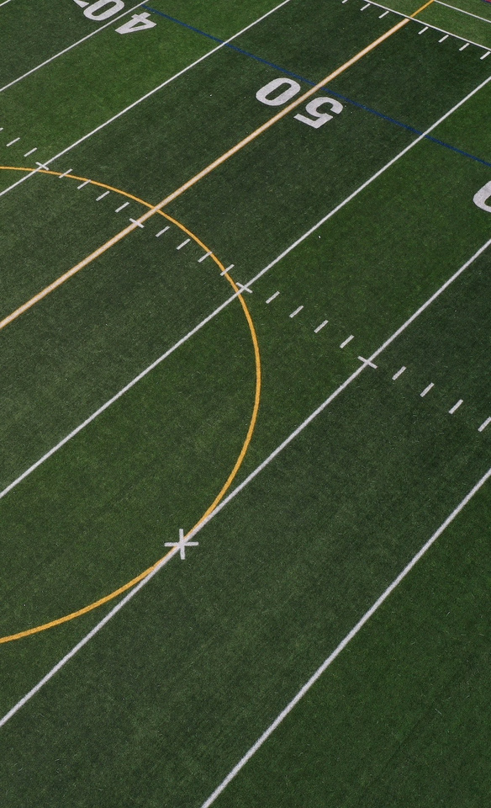
AGENDA
NCAA Eligibility Center.
  Choosing an NCAA School.
Registration is Required.
  Core Courses.
Certification Outcomes.
  Division I.
  Division II.
Recruiting.
Resources.

Slide 3
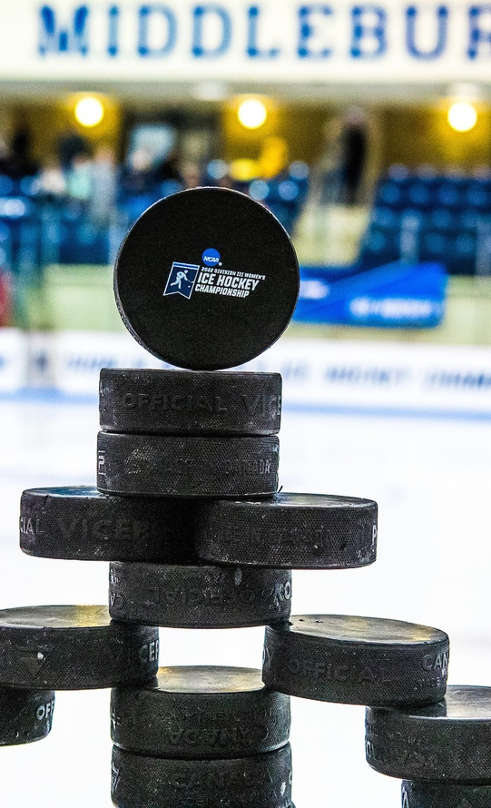
NCAA
ELIGIBILITY CENTER
» »
Who are we? A unit within the NCAA. What do we provide? Certification of
college-bound student-athletes for
collegiate competition.
»What do we review?
  Academic requirements.
  Amateurism requirements.
9

Slide 4
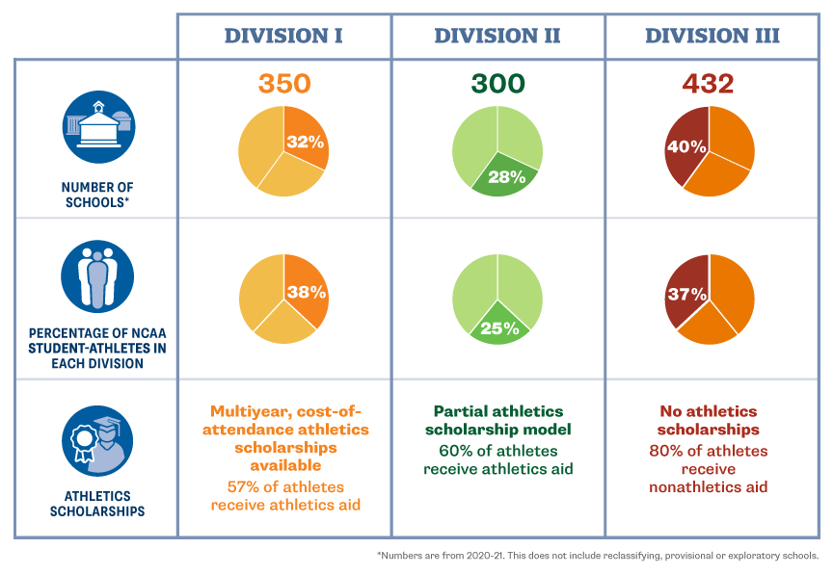
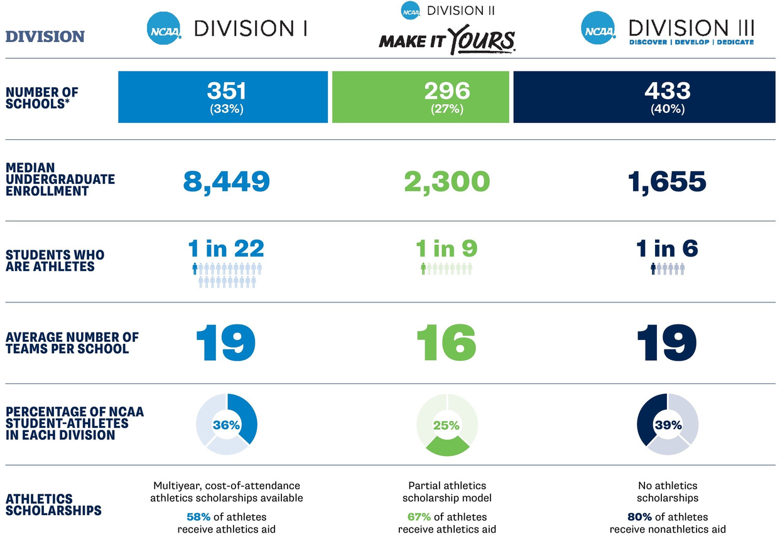
NCAA THREE DIVISIONS
11

Slide 5
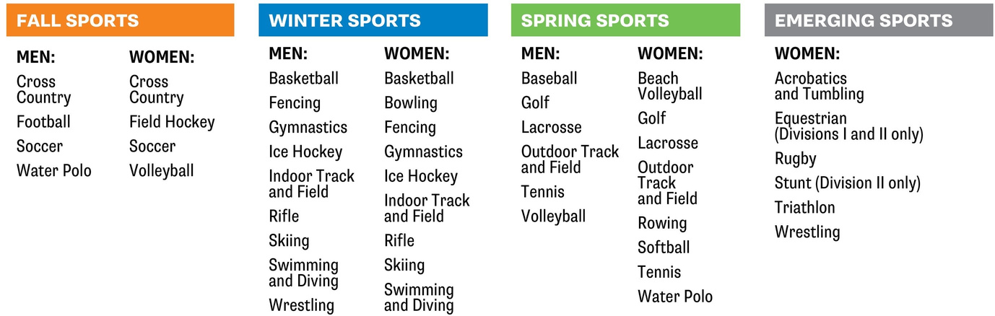
NCAA SPORTS
12

Slide 6




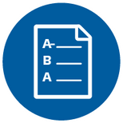



CHOOSING AN NCAA SCHOOL
School Size
School Location
Majors
and Minors
Cost of Attendance
Admission Requirements
Culture
and Affiliations
Student-to- Faculty Ratio
Playing Time
Use this interactive map to locate NCAA schools
you’re interested in attending.
13

Slide 7




THREE REQUIREMENTS
TO PLAY COLLEGE SPORTS
1
2
3
High School Graduation
NCAA
Initial Eligibility
College Admission
14

Slide 8
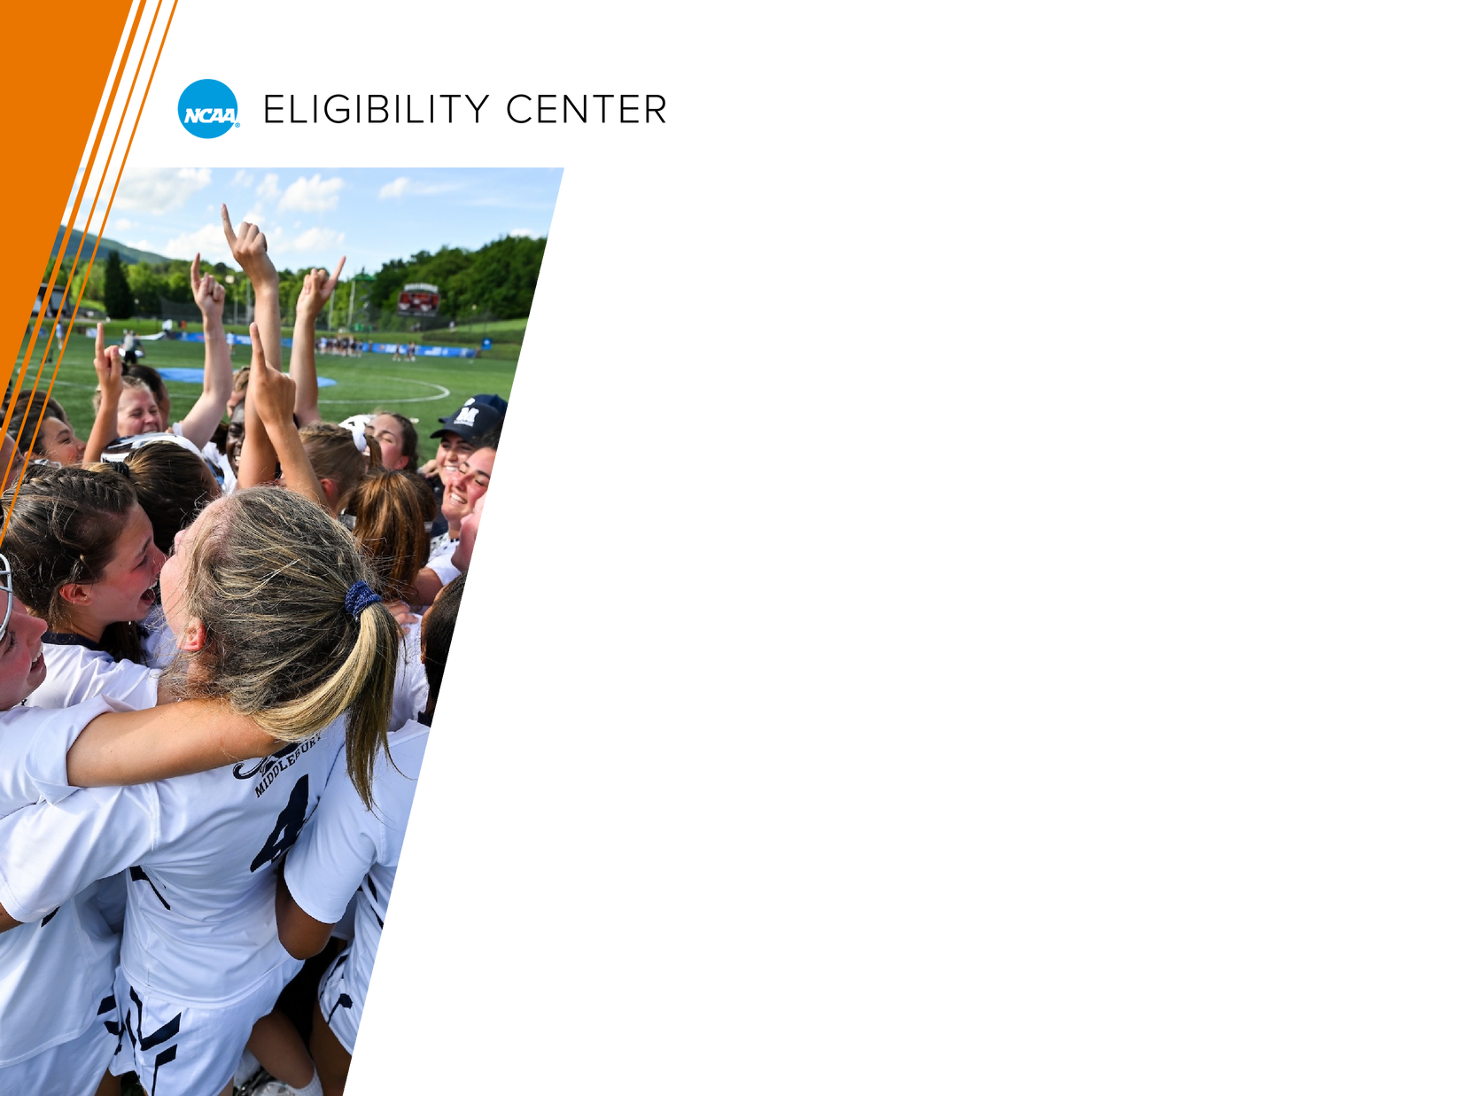
COLLEGE ADMISSION
Apply and be accepted to the NCAA
school before you can compete.
  NCAA certification does NOT include
acceptance to the NCAA school
recruiting you.
Ask college admission about:
  Cost of attendance.
  Financial aid.
  Standardized test scores.
May be required for college admission or scholarships.
NOT required for NCAA certification.
For more questions to ask, visit on.ncaa.com/ChoosingCollege.
15

Slide 9
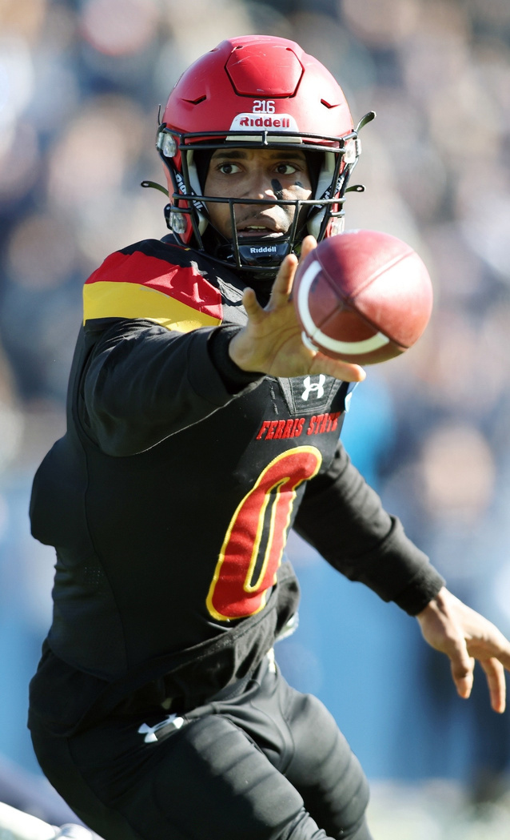
SCHOLARSHIPS BY SPORT
Only about 2% of high school-athletes are awarded athletics scholarships to compete in college.
Academic scholarships.
Athletics scholarships.
Expectations.
  Annual scholarships.
  Full scholarships.
  Partial scholarships.
  Scholarship renewals.
16

Slide 10
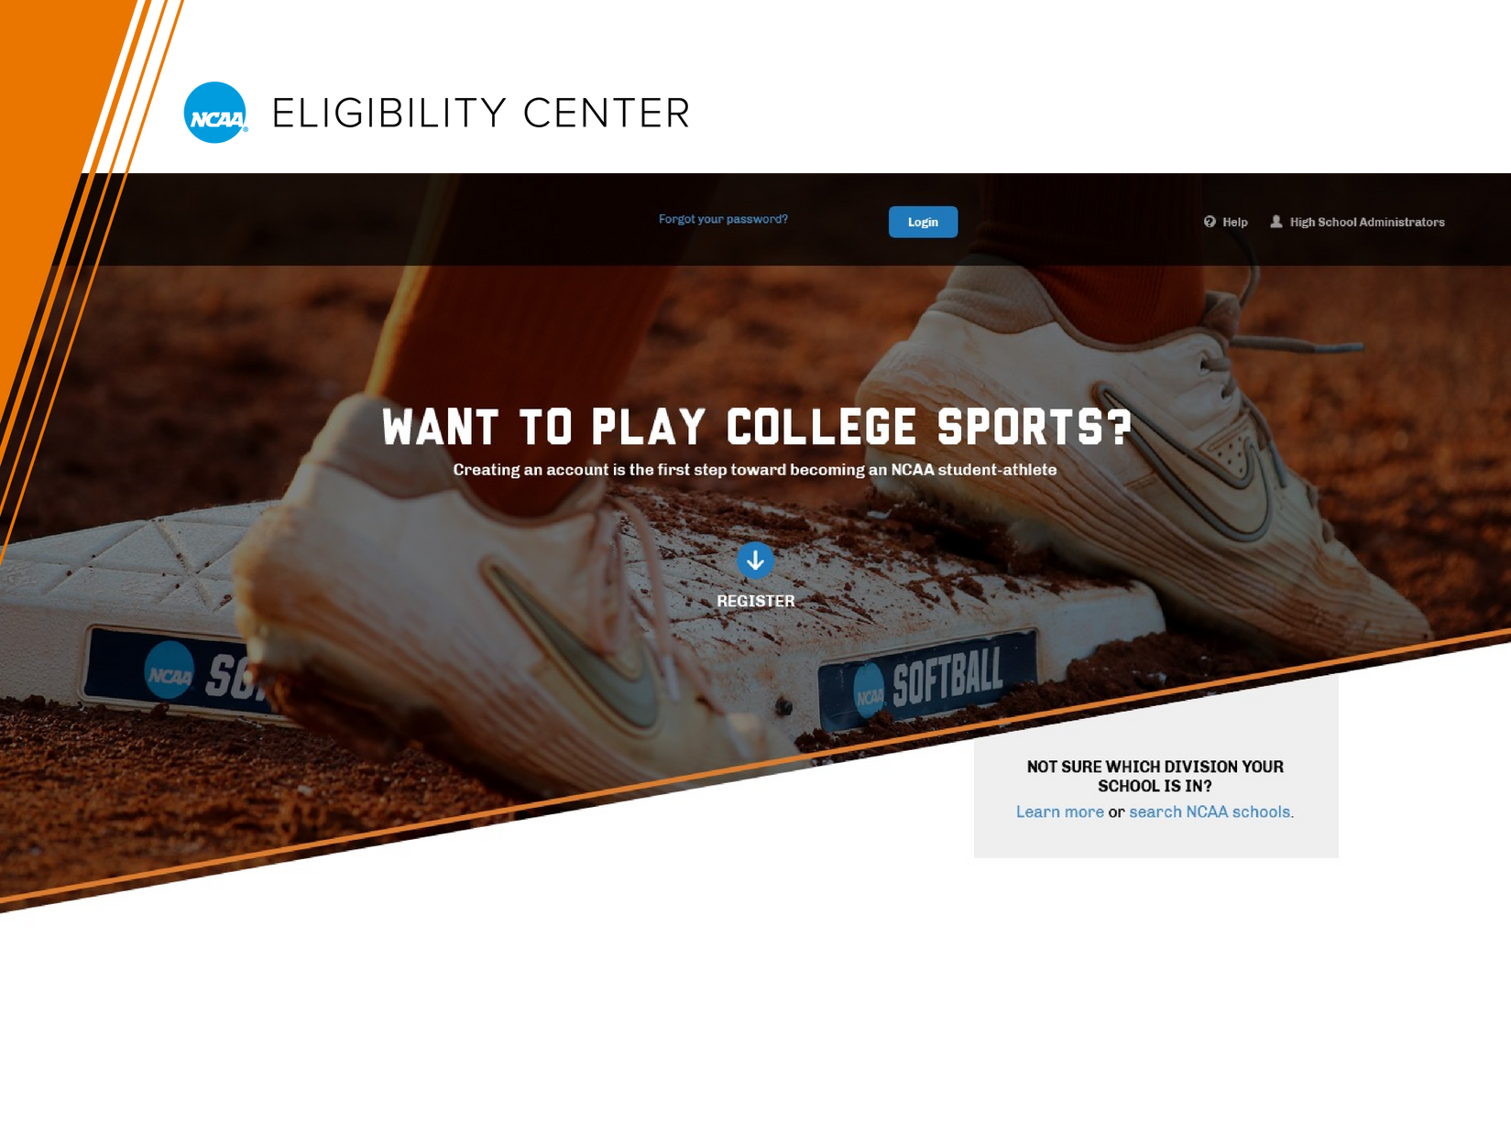
NCAA REGISTRATION IS REQUIRED

Slide 11



NCAA REGISTRATION IS REQUIRED
Three Account Types
1
2
3
Free Profile Page Account
Academic
and Amateurism Certification Account
Amateurism-Only Certification Account
19

Slide 12

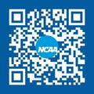

FREE PROFILE PAGE ACCOUNT
Account Type #1
The right place to start for most students!
» Not sure in which division you plan to compete. » Domestic students planning to compete at a
Division III school.
» Registering in an NCAA-certified non-scholastic
basketball event (BBCS, ECAG, AAU).
No registration fee.
Transition to the right certification account at any time.
20

Slide 13
ACADEMIC AND AMATEURISM CERTIFICATION ACCOUNT
Account Type #2
Required to compete at a Division I or II school.
Go on official visits.
Sign a National Letter of Intent.
Receive an athletics scholarship.
Registration fee:
Domestic students: $100.
International students: $160.
21

Slide 14

AMATEURISM-ONLY CERTIFICATION ACCOUNT
Account Type #3
Required for all international student-athletes planning to compete.
Registration fee: $70.
Student-athletes transferring from a
two-year school to an NCAA Division I or II
school who did not require an Eligibility
Center academic certification.
22

Slide 15

REMEMBER
If you have an Eligibility Center certification account check to see if you meet fee waiver criteria.
23

Slide 16
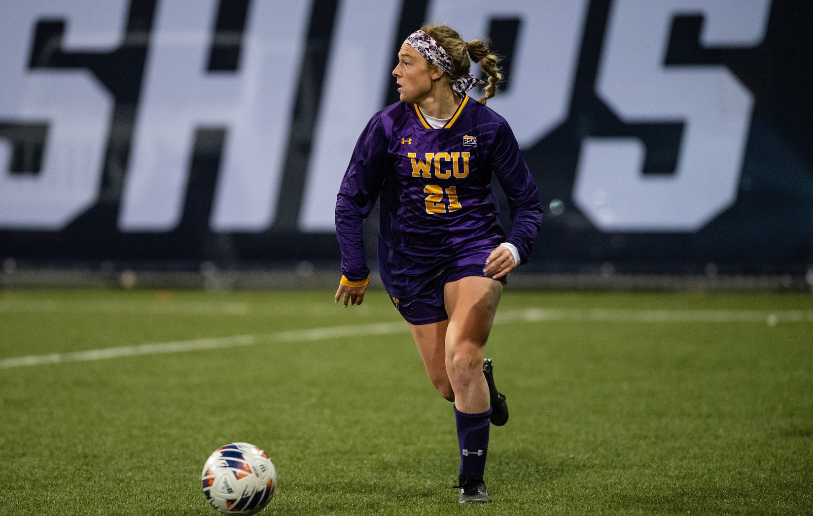
CORE COURSES

Slide 17

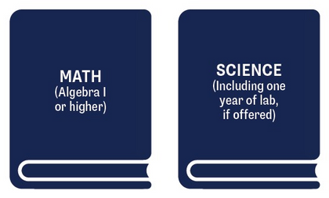


WHAT IS A CORE COURSE?
Meets all requirements for an NCAA-approved core course.
Find your high school’s list of NCAA-approved core courses.
27

Slide 18
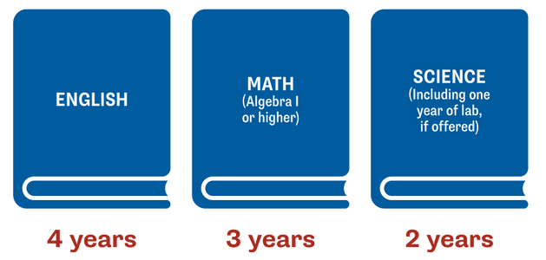
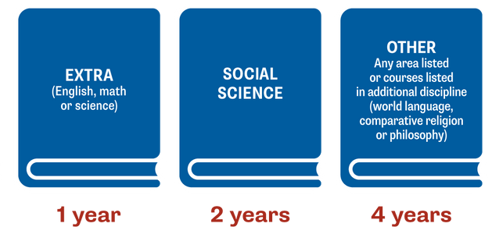
DIVISION I: 16 CORE-COURSE UNITS
Complete 16 core-course units in eight academic semesters.
28

Slide 19
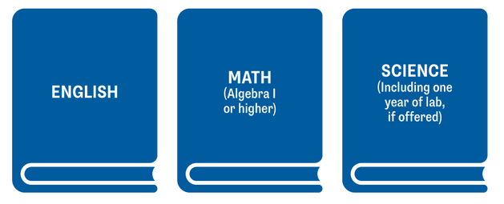
DIVISION I:
CORE-COURSE TIME LIMITATION
Complete 10 of your 16 NCAA-approved core-course credits, including seven in English, math or science, before the start of the seventh semester.
Once you begin your seventh semester, any course
that is needed to meet the 10/7 requirement
cannot be replaced or repeated.
29

Slide 20
DIVISION I:
CORE-COURSE TIME LIMITATION
Complete 10 of your 16 NCAA-approved core-course credits, including seven in English, math or science, before the start of the seventh semester.
Courses:
9th Grade Literature Biology
10th Literature Chemistry
American Literature Physics
Algebra Concepts Geometry Concepts Adv. Algebra Concepts World History
US History
»Once you begin your seventh semester, any course
that is needed to meet the 10/7 requirement
cannot be replaced or repeated.
29

Slide 21
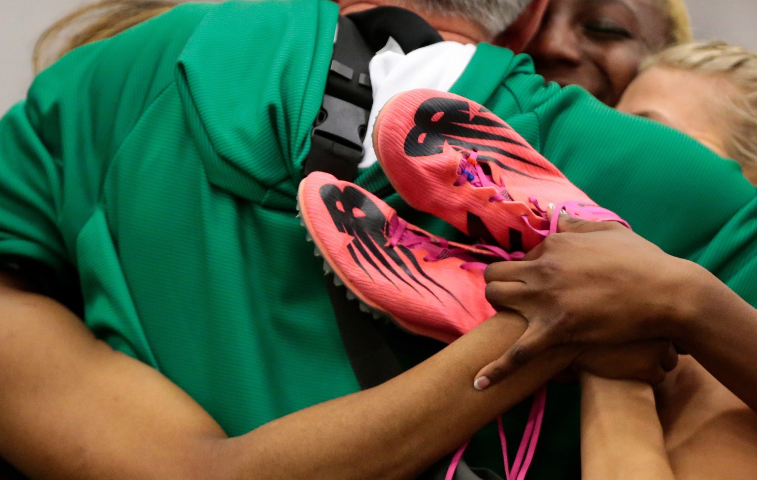
CERTIFICATION OUTCOMES
Divisions I and II

Slide 22
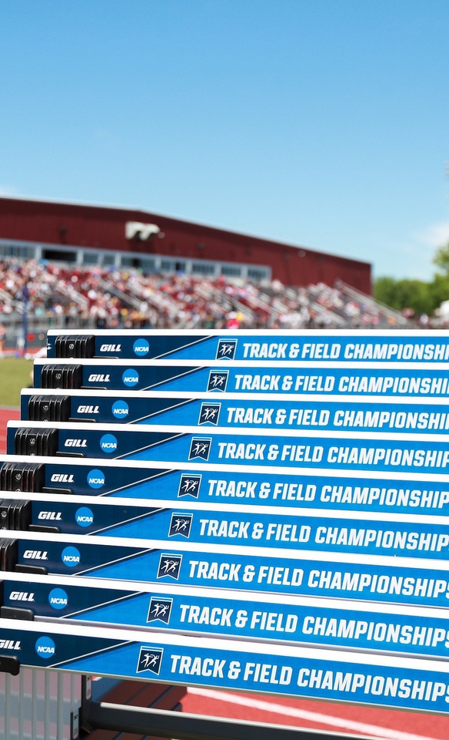
Division I
CERTIFICATION OUTCOMES
1. Early Academic Qualifier 2. Qualifier
3. Academic Redshirt
4. Nonqualifier
32

Slide 23
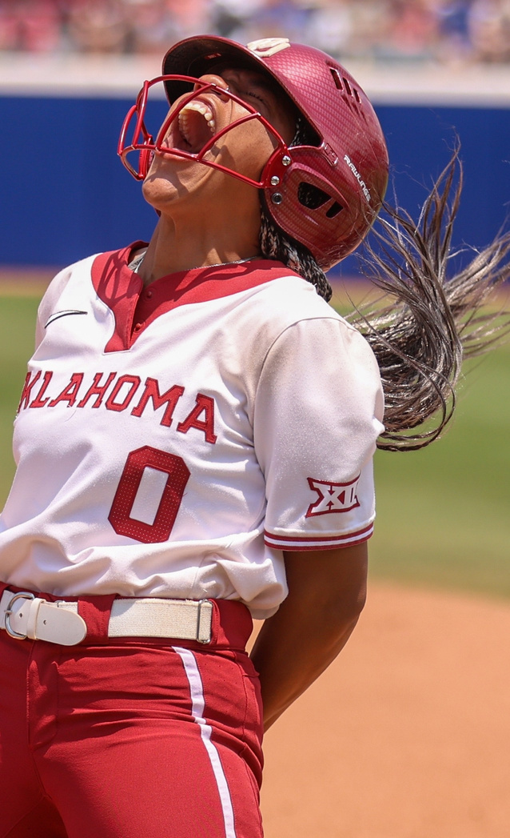

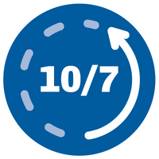



DIVISION I: QUALIFIER
Complete 16 core-course units in the required subject areas.
Meet core-course progression
before the seventh semester.
Note: Students certified based solely on international credentials are exempt from core-course progression.
» » »
Athletics Aid. Practice. Compete.
Earn a core-course GPA ≥2.3 in the required subject areas.
Submit proof of graduation to the Eligibility Center.
33

Slide 24
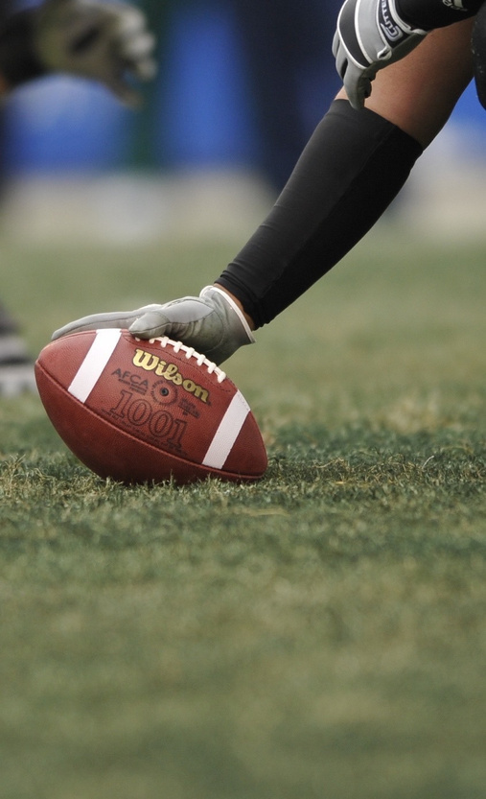


DIVISION I: ACADEMIC REDSHIRT
Complete 16 core-course units in the required subject areas.
Earn a core-course GPA ≥2.0 in the required subject areas.
»
»
First Year Athletics Aid.
First Term
Practice.
Submit proof of graduation to the Eligibility Center.
34

Slide 25
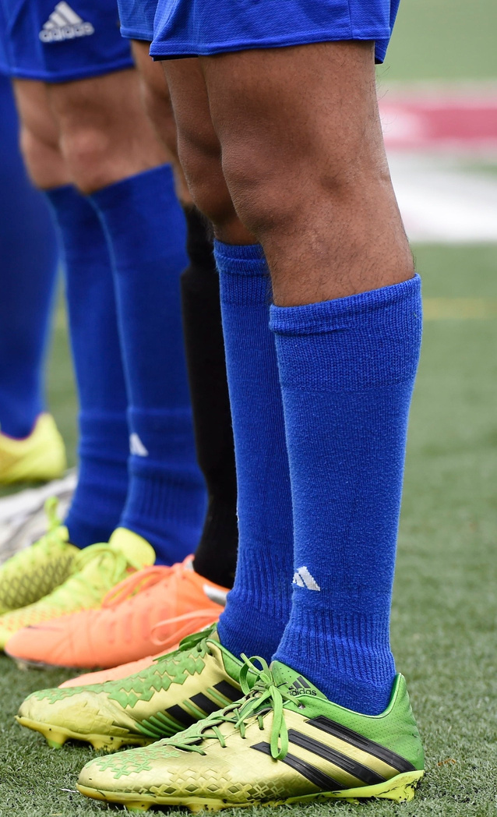


DIVISION I: NONQUALIFIER
Nonqualifiers are not eligible to receive athletics aid, practice or compete their first year at
an NCAA Division I school.
» » »
Athletics Aid. Practice. Compete.
35

Slide 26
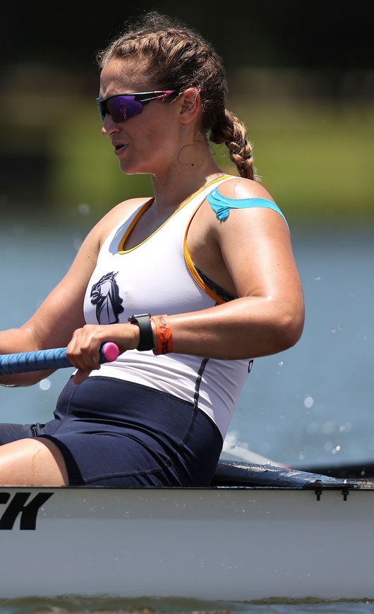
Division II
CERTIFICATION OUTCOMES
1. EarlyAcademic Qualifier
2. Qualifier.
3. Partial Qualifier
36

Slide 27
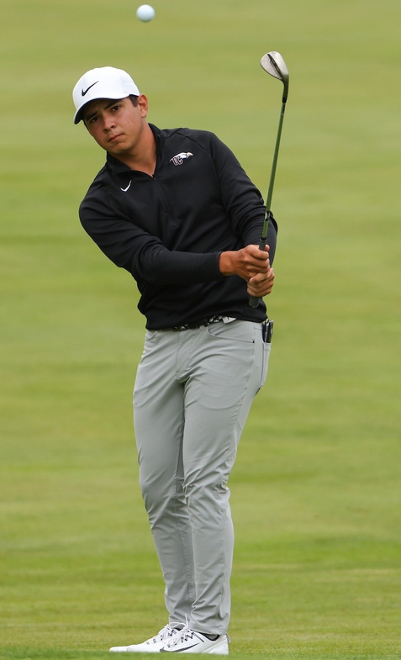

DIVISION II: QUALIFIER
Complete 16 core-course units in the required subject areas.
Earn a core-course GPA ≥2.2 in the required subject areas.
Submit proof of graduation to the Eligibility Center.
» » »
Athletics Aid. Practice. Compete.
37

Slide 28
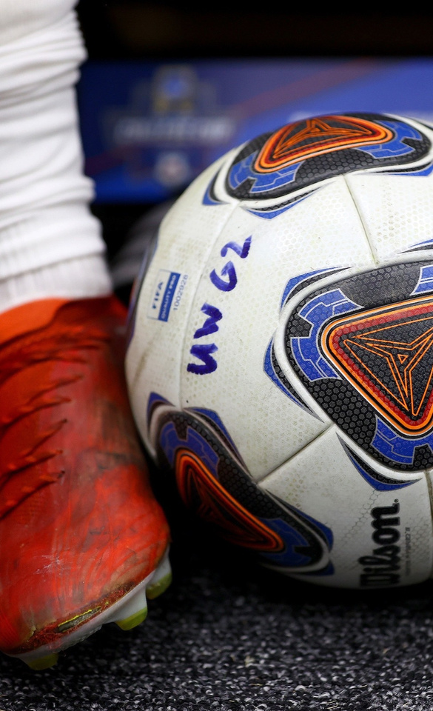
DIVISION II: PARTIAL QUALIFIER
College-bound student-athletes that do not meet Division II qualifier standards will be deemed a partial qualifier.
Submit proof of graduation to the Eligibility Center.
» »
Athletics Aid. Practice.
38

Slide 29
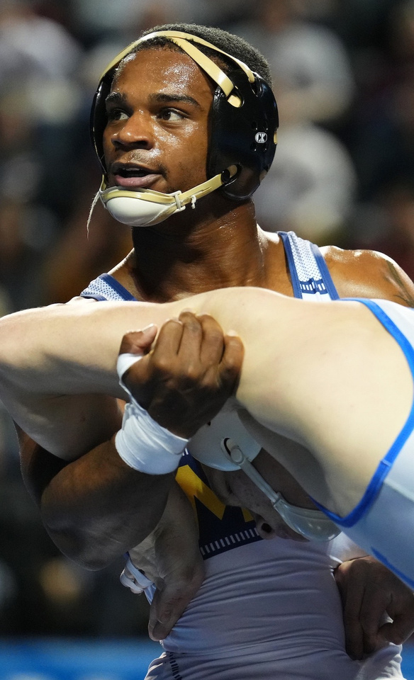

DIVISION III
Each Division III school determines
its own eligibility for:
  Academic requirements.
  Admission.
  Financial aid.
International student-athletes
who plan to compete at a Division III
school must complete an NCAA
Eligibility Center Amateurism-Only
Certification account.
Domestic student-athletes who
plan to compete at a Division III
school may register for a free
Profile Page account, but it is
not required.
39

Slide 30
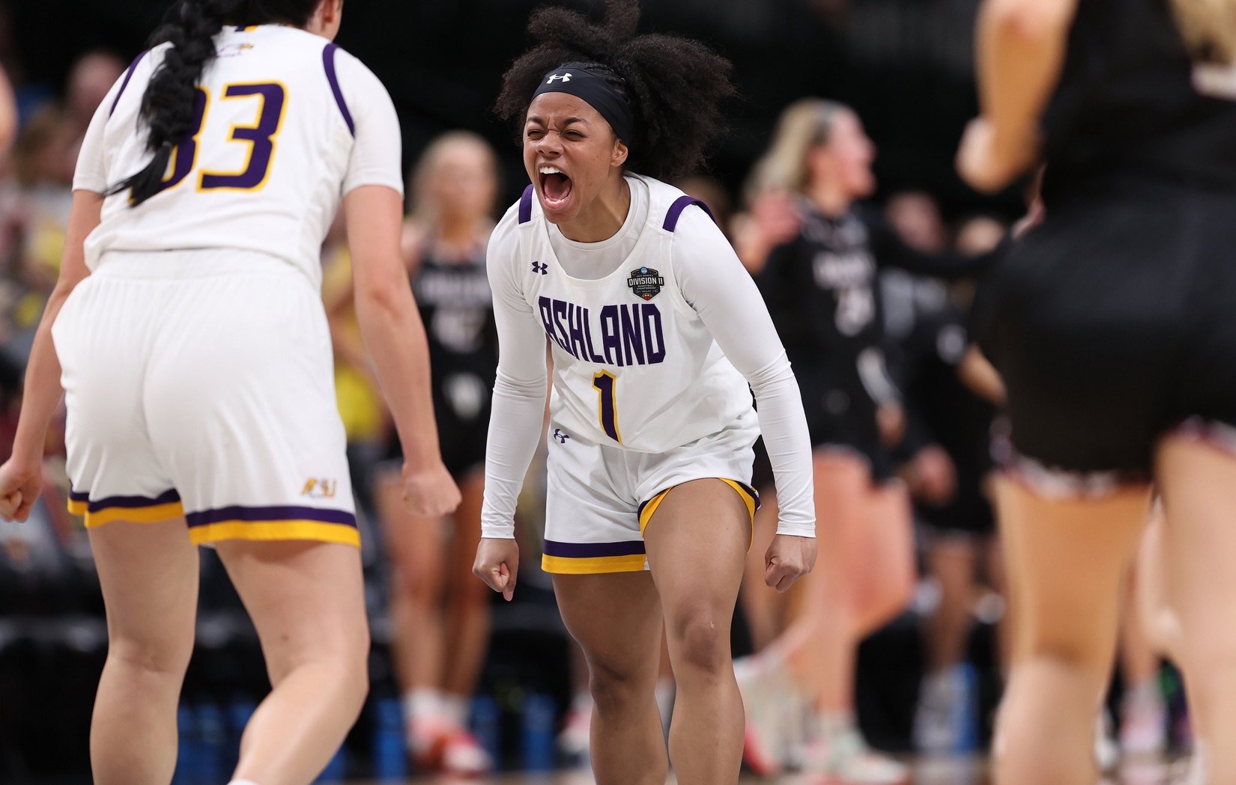
RECRUITING

Slide 31





ARE YOU BEING RECRUITED?
You’re being recruited if a college coach:
Calls
Texts
Emails
Messages via Social Media
Visits Your High School
Pays Expenses to Visit Campus
Issues National Letter of Intent
Writes Offer
of Financial Aid
Recruiting can begin as early as freshman year. In most cases, recruiting starts before junior year.
44

Slide 32
INSTITUTIONAL REQUEST LIST
An IRL is a list of college-bound student-athletes an NCAA school is interested in recruiting.
You must be on an NCAA school’s IRL to receive an
Eligibility Center certification.
> > >
Receive athletics aid. Practice.
Compete.
45

Slide 33


OFFICIAL VS UNOFFICIAL VISITS
OFFICIAL VISITS
Official visits are any visit to a college campus paid for by the NCAA school you’re visiting. Before a Division I or II official visit, you must:
Register for a Certification Account
Be on an IRL
Send Your High School Transcripts
UNOFFICIAL VISITS
Unofficial visits are any visit to a college campus paid by you or your family members.
47

Slide 34
QUESTIONS TO ASK NCAA COACHES
Additional team responsibilities.
Athletic training and medical expenses.
Coaching philosophy and style.
Degree completion support.
Injuries and rehabilitation.
Mental health resources.
Playing time.
  Am I a top seed, five seed or standby recruit?
    Are there any redshirt expectations?
Scholarship renewals.
  Will I receive a full or partial scholarship?
  If I’m injured will my scholarship remain?
Team time demands.
49

Slide 35
RECRUITING BEST PRACTICES
Talk with your support system about what level of
competition they think you should aim for.
Check your email often for open Eligibility Center tasks.
Check the interactive map on the eligibility center site to locate NCAA schools you’re interested in attending.
Research admission requirements to NCAA schools
you’re interested in attending.
Research your division-and sport-specific
recruiting periods.
50

Slide 36
RECRUITING BEST PRACTICES
Consider elite travel teams and camps.
Email college coaches during your sport’s contact period
to share your achievements and your interest.
  Include your name, position and NCAA ID.
Your Name
NCAA ID: 1234567890
Grad: MM/YYYY | Enroll: SEASON YYYY
Take official and unofficial visits to NCAA schools.
  Review school websites and take virtual campus tours
to learn more about NCAA schools.
Conduct yourself in a positive manner in class, practices
and games, at home, in your community and online.
51

Slide 37

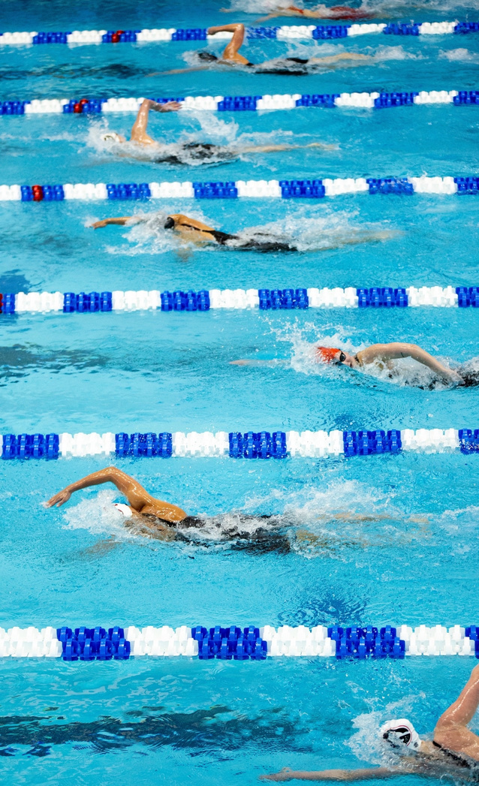
NATIONAL
LETTER OF INTENT
By signing a NLI, you’re agreeing to
attend a Division I or II school for one
academic year.
NLI is voluntary and ends the
recruiting process.
Athletics financial aid is provided for
a minimum of one academic year.
  You must be admitted to the
NCAA school.
  You must be eligible for
financial aid under NCAA rules.
For more NLI information,
visit nationalletter.org.
53

Slide 38
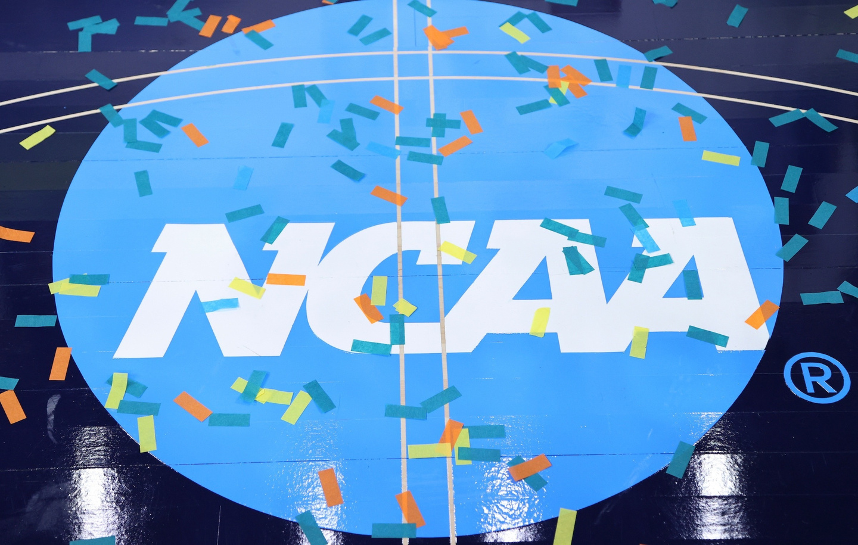
RESOURCES

Slide 39

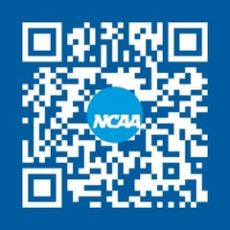




RESOURCES
Guide for the College-Bound Student-Athlete.
Initial-Eligibility Flyer.
Home School Students.
International Students.
Education Impacting Disabilities.
Register at eligibilitycenter.org.
Registration Checklist
@ncaaec
@playcollegesports
@ncaaec
@ncaaec
NCAA is a trademark of the National Collegiate Athletic Association.

Slide 40
GHSA Eligibility
Students must pass 2.5 units the prior semester.
Promotion for Eligibility
10th grade = 5 units
11th grade = 11 units
12th grade = 17 units
3. This is important when planning for summer school. Summer school can count towards the 2.5 prior semester #’s and the total needed for eligibility. Courses must be completed before the first day of school. Not all summer school options are NCAA approved.

Slide 41
QUESTIONS ?

Slide 42

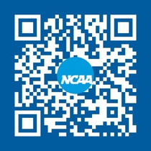
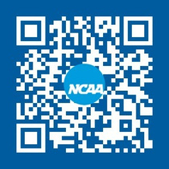
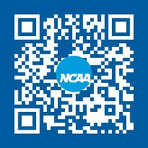
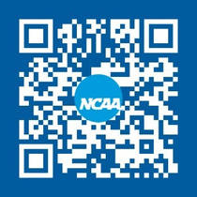
SOCIAL MEDIA
Follow the NCAA Eligibility Center
Twitter @ncaaec
Instagram @playcollegesports
Facebook @ncaaec
YouTube @ncaaec

Slide 43
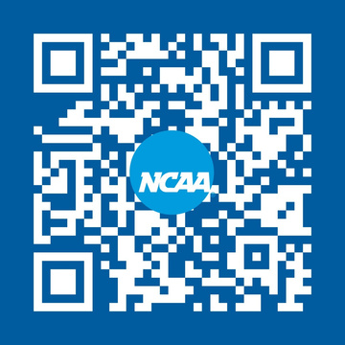
THANK YOU FOR JOINING!
Contact the Eligibility Center
»
College-bound student-athlete support line.
877-262-1492.
> Monday-Friday.
>9 a.m. to 5 p.m. Eastern time.
Connect with the Eligibility Center
@ncaaec
@playcollegesports
@ncaaec
@ncaaec
NCAA is a trademark of the National Collegiate Athletic Association.

